Slide 1
IT305 Computer Networks Week11_Lec 1
Link State Algorithm

Slide 2
What is a link state?
Link – Interface
State of the link
Description of the interface
Relationship to neighbor routers
Interface
IP address
Mask
Network type
Routers connected to

Slide 3
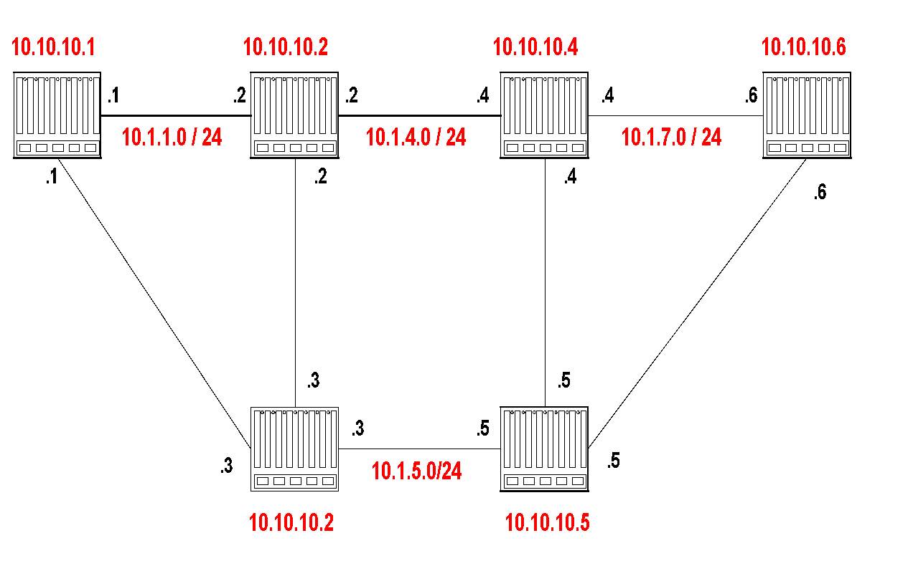
Link state Advertisements
The LSA of router 10.10.10.1 is as follows:
Link State ID: 10.10.10.1 = can be Router ID
Advertising Router: 10.10.10.1 = Router ID
Number of links: 3 = 2 links plus router itself
Description of Link 1: Link ID = 10.1.1.1, Metric = 4
Description of Link 2: Link ID = 10.1.2.1, Metric = 3
Description of Link 3: Link ID = 10.10.10.1, Metric = 0

Slide 4
Dijkstra’s link-state routing algorithm
centralized: network topology, link costs known to all nodes
accomplished via “link state broadcast”
all nodes have same info
computes least cost paths from one node (“source”) to all other nodes
gives forwarding table for that node
iterative: after k iterations, know least cost path to k destinations
notation
c_{x,y}: direct link cost from node x to y; = ∞ if not direct neighbors
D(v): current estimate of cost of least-cost-path from source to destination v
p(v): predecessor node along path from source to v
N': set of nodes whose least-cost-path definitively known

Slide 5
Example of topology to Graph structure
A point-to-point connection between two routers is represented by a pair of arcs, one in each direction. Their weights may be different.
A broadcast network is represented by a node for the network itself, plus a node for each router.
The arcs from that network node to the routers have weight 0. They are important nonetheless, as without them there is no path through the network.
Other networks, which have only hosts, have only an arc reaching them and not one returning. This structure gives routes to hosts, but not through them.

Slide 6
Dijkstra’s link-state routing algorithm
1 Initialization:
2 N' = {u} /* compute least cost path from u to all other nodes */
3 for all nodes v
4 if v adjacent to u /* u initially knows direct-path-cost only to direct neighbors */
5 then D(v) = c_{u,v} /* but may not be minimum cost! */
6 else D(v) = ∞
7
8 Loop
9
10
11
12
13
14
15 until all nodes in N'
find w not in N' such that D(w) is a minimum
add w to N'
update D(v) for all v adjacent to w and not in N' :
D(v) = min ( D(v), D(w) + c_{w,v} )
/* new least-path-cost to v is either old least-cost-path to v or known
least-cost-path to w plus direct-cost from w to v */

Slide 7
Dijkstra’s algorithm: an example
v
w
x
y
z
Step
0
1
2
3
4
5
N'
D(v),p(v)
D(w),p(w)
D(x),p(x)
D(y),p(y)
D(z),p(z)
u
2,u
5,u
1,u
∞
∞
D(w),p(w)
5,u
4,x
3,y
3,y
5
Initialization (step 0):
For all a: if a adjacent to u then D(a) = c_{u,a}
v
3
w
2
5
u
2
1
z
3
1
2
x
y
1

Slide 8
Dijkstra’s algorithm: an example
v
w
x
y
z
Step
0
1
2
3
4
5
N'
D(v),p(v)
D(w),p(w)
D(x),p(x)
D(y),p(y)
D(z),p(z)
u
2,u
5,u
1,u
∞
∞
ux
D(w),p(w)
5,u
4,x
3,y
3,y
8 Loop
9
10
find a not in N' such that D(a) is a minimum
add a to N'
5
v
3
w
2
5
u
2
1
z
3
1
2
x
y
1

Slide 9

Dijkstra’s algorithm: an example
v
w
x
y
z
Step
0
1
2
3
4
5
N'
D(v),p(v)
D(w),p(w)
D(x),p(x)
D(y),p(y)
D(z),p(z)
u
2,u
5,u
1,u
∞
∞
ux
2,u
4,x
2,x
∞
D(w),p(w)
5,u
4,x
3,y
3,y
8 Loop
9
10
11
find a not in N' such that D(a) is a minimum
add a to N'
5
v
3
w
2
5
update D(b) for all b adjacent to a and not in N' :
D(b) = min ( D(b), D(a) + c_{a,b} )
u
2
1
z
3
1
2
D(v) = min ( D(v), D(x) + c_{x,v} ) = min(2, 1+2) = 2
x
y
1
D(w) = min ( D(w), D(x) + c_{x,w} ) = min (5, 1+3) = 4
D(y) = min ( D(y), D(x) + c_{x,y} ) = min(inf,1+1) = 2

Slide 10
Dijkstra’s algorithm: an example
v
w
x
y
z
Step
0
1
2
3
4
5
N'
D(v),p(v)
D(w),p(w)
D(x),p(x)
D(y),p(y)
D(z),p(z)
u
2,u
5,u
1,u
∞
∞
ux
2,u
4,x
2,x
∞
uxy
D(w),p(w)
5,u
4,x
3,y
3,y
8 Loop
9
10
find a not in N' such that D(a) is a minimum
add a to N'
5
v
3
w
2
5
u
2
1
z
3
1
2
x
y
1

Slide 11
Dijkstra’s algorithm: an example
v
w
x
y
z
Step
0
1
2
3
4
5
N'
D(v),p(v)
D(w),p(w)
D(x),p(x)
D(y),p(y)
D(z),p(z)
u
2,u
5,u
1,u
∞
∞
ux
2,u
4,x
2,x
∞
uxy
2,u
3,y
4,y
8 Loop
9
10
11
find a not in N' such that D(a) is a minimum
add a to N'
5
v
3
w
2
5
update D(b) for all b adjacent to a and not in N' :
D(b) = min ( D(b), D(a) + c_{a,b} )
u
2
1
z
3
1
2
D(w) = min ( D(w), D(y) + c_{y,w} ) = min (4, 2+1) = 3
x
y
1
D(z) = min ( D(z), D(y) + c_{y,z} ) = min(inf,2+2) = 4

Slide 12
Dijkstra’s algorithm: an example
v
w
x
y
z
Step
0
1
2
3
4
5
N'
D(v),p(v)
D(w),p(w)
D(x),p(x)
D(y),p(y)
D(z),p(z)
u
2,u
5,u
1,u
∞
∞
ux
2,u
4,x
2,x
∞
uxy
2,u
3,y
4,y
uxyv
8 Loop
9
10
find a not in N' such that D(a) is a minimum
add a to N'
5
v
3
w
2
5
u
2
1
z
3
1
2
x
y
1

Slide 13
Dijkstra’s algorithm: an example
v
w
x
y
z
Step
0
1
2
3
4
5
N'
D(v),p(v)
D(w),p(w)
D(x),p(x)
D(y),p(y)
D(z),p(z)
u
2,u
5,u
1,u
∞
∞
ux
2,u
4,x
2,x
∞
uxy
2,u
3,y
4,y
uxyv
3,y
4,y
8 Loop
9
10
11
find a not in N' such that D(a) is a minimum
add a to N'
5
v
3
w
2
5
update D(b) for all b adjacent to a and not in N' :
D(b) = min ( D(b), D(a) + c_{a,b} )
u
2
1
z
3
1
2
D(w) = min ( D(w), D(v) + c_{v,w} ) = min (3, 2+3) = 3
x
y
1

Slide 14
Dijkstra’s algorithm: an example
v
w
x
y
z
Step
0
1
2
3
4
5
N'
D(v),p(v)
D(w),p(w)
D(x),p(x)
D(y),p(y)
D(z),p(z)
u
2,u
5,u
1,u
∞
∞
ux
2,u
4,x
2,x
∞
uxy
2,u
3,y
4,y
uxyv
3,y
4,y
uxyvw
8 Loop
9
10
find a not in N' such that D(a) is a minimum
add a to N'
5
v
3
w
2
5
u
2
1
z
3
1
2
x
y
1

Slide 15
Dijkstra’s algorithm: an example
v
w
x
y
z
Step
0
1
2
3
4
5
N'
D(v),p(v)
D(w),p(w)
D(x),p(x)
D(y),p(y)
D(z),p(z)
u
2,u
5,u
1,u
∞
∞
ux
2,u
4,x
2,x
∞
uxy
2,u
3,y
4,y
uxyv
3,y
4,y
uxyvw
4,y
8 Loop
9
10
11
find a not in N' such that D(a) is a minimum
add a to N'
5
v
3
w
2
5
update D(b) for all b adjacent to a and not in N' :
D(b) = min ( D(b), D(a) + c_{a,b} )
u
2
1
z
3
1
2
D(z) = min ( D(z), D(w) + c_{w,z} ) = min (4, 3+5) = 4
x
y
1

Slide 16
Dijkstra’s algorithm: an example
v
w
x
y
z
Step
0
1
2
3
4
5
N'
D(v),p(v)
D(w),p(w)
D(x),p(x)
D(y),p(y)
D(z),p(z)
u
2,u
5,u
1,u
∞
∞
ux
2,u
4,x
2,x
∞
uxy
2,u
3,y
4,y
uxyv
3,y
4,y
uxyvw
4,y
uxyvwz
8 Loop
9
10
find a not in N' such that D(a) is a minimum
add a to N'
5
v
3
w
2
5
u
2
1
z
3
1
2
x
y
1

Slide 17
Dijkstra’s algorithm: an example
v
w
x
y
z
Step
0
1
2
3
4
5
N'
D(v),p(v)
D(w),p(w)
D(x),p(x)
D(y),p(y)
D(z),p(z)
u
2,u
5,u
1,u
∞
∞
ux
2,u
4,x
2,x
∞
uxy
2,u
3,y
4,y
uxyv
3,y
4,y
uxyvw
4,y
uxyvwz
8 Loop
9
10
11
find a not in N' such that D(a) is a minimum
add a to N'
5
v
3
w
2
5
update D(b) for all b adjacent to a and not in N' :
D(b) = min ( D(b), D(a) + c_{a,b} )
u
2
1
z
3
1
2
x
y
1

Slide 18
Dijkstra’s algorithm: an example
v
w
x
y
z
Step
0
1
2
3
4
5
N'
D(v),p(v)
D(w),p(w)
D(x),p(x)
D(y),p(y)
D(z),p(z)
u
2,u
5,u
1,u
∞
∞
ux
2,u
4,x
2,x
∞
uxy
2,u
3,y
4,y
uxyv
3,y
4,y
D(w),p(w)
5,u
4,x
3,y
3,y
uxyvw
4,y
uxyvwz
Initialization (step 0): For all a: if a adjacent to then D(a) = c_{u,a}
5
find a not in N' such that D(a) is a minimum
add a to N'
update D(b) for all b adjacent to a and not in N' :
D(b) = min ( D(b), D(a) + c_{a,b} )
v
3
w
2
5
u
2
1
z
3
1
2
x
y
1

Slide 19
Dijkstra’s algorithm: an example
5
v
3
w
2
5
u
2
1
z
3
1
2
D(w),p(w)
5,u
4,x
3,y
3,y
x
y
1
resulting least-cost-path tree from u:
resulting forwarding table in u:
v
w
destination
outgoing link
v
x
y
w
x
(u,v)
(u,x)
(u,x)
(u,x)
(u,x)
route from u to v directly
u
z
x
route from u to all other destinations via x
y

Slide 20
Dijkstra’s algorithm: another example
v
w
x
y
z
x
D(v),
p(v)
D(w),
p(w)
D(x),
p(x)
D(y),
p(y)
D(z),
p(z)
9
Step
N'
0
u
7,u
3,u
5,u
∞
∞
5
7
4
1
uw
6,w
5,u
11,w
∞
8
2
uwx
6,w
11,w
14,x
u
3
w
y
z
2
3
uwxv
10,v
14,x
3
4
uwxvy
12,y
7
4
5
uwxvyz
v
notes:
construct least-cost-path tree by tracing predecessor nodes
ties can exist (can be broken arbitrarily)

Slide 21
Dijkstra’s algorithm: discussion
algorithm complexity: n nodes
each of n iteration: need to check all nodes, w, not in N
n(n+1)/2 comparisons: O(n²) complexity
message complexity:
each router must broadcast its link state information to other n routers
efficient (and interesting!) broadcast algorithms: O(n) link crossings to disseminate a broadcast message from one source
each router’s message crosses O(n) links: overall message complexity: O(n²)

Slide 22
Comparison of LS and DV algorithms
message complexity
LS: n routers, O(n²) messages sent
DV: exchange between neighbors; convergence time varies
robustness: what happens if router malfunctions, or is compromised?
LS:
router can advertise incorrect link cost
each router computes only its own table
DV:
DV router can advertise incorrect path cost (“I have a really low-cost path to everywhere”): black-holing
each router’s DV is used by others: error propagate thru network
speed of convergence
LS: O(n²) algorithm, O(n²) messages
may have oscillations
DV: convergence time varies
may have routing loops
count-to-infinity problem

